Slide 1
Talking with Parents When You Have Concerns About a Child in Your Care
Developed by
California MAP to Inclusion & Belonging
WestEd Center for Child & Family Studies
Based on the article “Talking with Parents When Concerns Arise”
by Linda Brault and Janet Gonzalez-Mena
California MAP to Inclusion & Belonging is funded by the California Department of Education, Child Development Division, with a portion of the federal Child Care Development Fund Quality Improvement Allocation
Notes:
The article “Talking with Parents When Concerns Arise” by Linda Brault and Janet Gonzalez-Mena (11/16/07 revision) should be provided when this presentation is given. Additionally, the presenter should be very familiar with the content of the article and have specific resources, examples, and ideas for the particular audience.
The November 2019 version includes: content update (slide 19), updates to website links (slides 20 & 21) and accessibility updates

Slide 2
Conditions for Use of This Presentation
This PowerPointTM and accompanying notes were developed by the California MAP to Inclusion & Belonging for use in training and educational settings
The content was reviewed and approved by the California Department of Education, Child Development Division
The information regarding the laws and regulations, as well as the website links, were accurate at the time of distribution
Modification of the content is not permitted
Users are free to duplicate this material in its entirety, with appropriate credit, for educational purposes only
Notes:
Use of the Notes Pages
The notes are included to provide clarification, additional information, and examples for those presenting this information to others. Presenters are encouraged to review the notes and companion article as they prepare to share the PowerPointTM slides.
When sharing these slides with the audience, it is likely that questions will be raised that cannot be answered given the information contained in the notes. It would be helpful to have local resource information, including referrals, available for those who would like additional information or to address individual issues.
While these slides present a method of sharing information and possible family reactions to the sharing, some individuals may have had a different experience personally. Presenters are encouraged to listen with empathy, yet reinforce that the slides represent an overview; and that individual experiences may vary.
Presenters are welcome to add activities or information to the presentation that assist their audience in understanding and implementing the concepts. For example, having participants engage in a role play between child care providers and family members can help participants practice sharing concerns sensitively.

Slide 3
Intent of This Presentation
To provide a framework for caregivers (anyone providing child care or out-of-school care for children)
when they have concerns that a child in their care might have a developmental delay, disability, or significant behavior problem
when preparing to share concerns with a child’s parents or family members (anyone raising the child)
in understanding different ways family members will receive and act on the expressed concern
Notes:
This presentation and the article it is based on is intended to provide a framework to help caregivers* refer families to support services that might be needed by a child.
The most important elements of this approach are:
a trusting relationship with the parent and/or family members**
genuine respect
understanding of the family’s feelings and decisions
ongoing support and acceptance of the child
The caregiver’s approach to the family may make all the difference in the family’s reaction and follow-up.
* The term caregiver is used to mean anyone who is being paid to care for a child, including family child care providers, early childhood teachers, preschool teachers, Head Start staff, nannies, before and after school staff, and so on.
** The terms parent and family member are used interchangeably to represent those individuals who are raising the child. It could be a mother, father, grandparent, foster parent, or other relative.

Slide 4
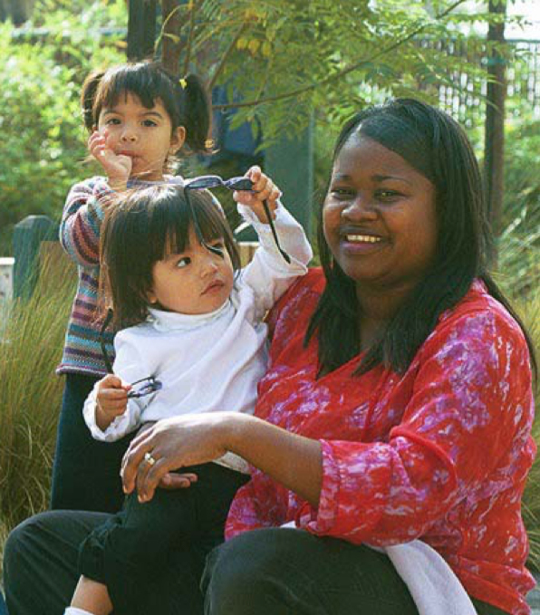
Talking with Parents When Concerns Arise
As a caregiver, you may be the first person to notice a child who learns or communicates differently
How do you determine that the difference is something to be concerned about?
How do you decide when to have a formal conference to talk to parents or family members about your concerns?
Notes:
It may be helpful to remind caregivers that they see children in groups, while family members may not see the child in relation to other children of the same age. A parent may be less familiar with developmental progression and expectations for children, particularly if this child is a first child. There may be differences in cultural expectations or values regarding development or behavior.
Caregivers who have a “gut instinct” that something is different about a child should generally follow up on that feeling by more careful observation and thought about what the difference is specifically. While parents should not be left out of discussions, it is not helpful to mention a very general concern to a family. Rather than make a general, overview comment about a concern, it is helpful to have specific examples to provide more clarity regarding your concern.
Examples from the article are helpful to review.
General concern (not helpful to the family):
Rashad seems too easygoing
Sarali is always in the middle of trouble
Specific examples of behavior (provides clarity of concern):
Rashad stays in one position for up to 30 minutes and doesn’t change positions on his own
Sarali has trouble sitting at the table during snack time and often hits children

Slide 5
When to Have a Conference
When you notice a difference in a child, you must think about that difference in relation to
typical, expected development
individual variations
interference with the child’s ability to learn and grow
If your careful observation and efforts to work effectively with a particular child
do not seem to be meeting the child’s needs and/or
you feel that additional expertise is needed
it’s time to look for help and plan to formally discuss your concerns and ideas with the parent
Notes:
It is important to emphasize the need for a strong understanding of typical development and the wide range of what is considered typical or expected. For children with different cultural backgrounds, there may be different child-rearing methods and expectations. If the language spoken at home is different than what is spoken in the setting, the caregiver should check to be sure that the differences in the child’s understanding are not contributing to the concerns. Careful observation, documentation of what is observed, any strategies used to support the child, and the child’s response to strategies will help the caregiver when they share their concerns with the family.
As described in the next slide, sharing concerns should not be the first conversation that a caregiver has with a family.

Slide 6
The Caregiver’s Emotional Response
Often when you, as a caregiver, are concerned about a child’s development or behavior, you will probably have an emotional response
You may feel sad, nervous, or worried about what the future will be for this child
You may feel that the needs of this child are beyond your abilities to care for the child
You may be frustrated or angry that the family members have not done something to help the child
Notes:
One thing to keep in mind is that the caregiver might have an emotional response to the possibility of a child having a delay or difference in development.
Noticing a difference in development can make the caregiver sad, nervous, upset, or anxious to get help. Their own emotional response will impact the way they share the information with the family.
The When Concerns Arise article discusses the range of feelings and some of the reasons a caregiver might have particular feelings. Exploration of differences with regard to independence and interdependence might be useful if the group is less familiar with these concepts.
The participants may be able to share and discuss some of their own feelings. Help the participants to avoid stereotypes while being sensitive to cultural variations.

Slide 7
Get to Know Your Feelings
It can be helpful to explore your reactions and feelings regarding your concerns for this child
What does the possibility that there are delays or behavior differences bring up in you emotionally?
Talk with a trusted colleague or other appropriate person about the situation
By understanding what you may be feeling, you can keep those feelings from interfering with your conversation with the family
Your fears, frustrations, or feelings may not be accurate to this child’s specific situation
Notes:
Caregivers need to take the time to uncover their own emotional responses before meeting with the family. It may be helpful for the caregiver to talk with a colleague or the director about these feelings. Confidentiality is an important aspect to emphasize. The sharing about the situation should not be specific about the family unless the listener is part of the staff. The discussion also needs to occur in a private location, not a restaurant or crowded staff room.
Knowing what the family’s feelings are can help the caregivers anticipate what reactions they may have when sharing the information. For example, caregivers may be surprised if a family member agrees with their observations, yet is not very worried. Or, a caregiver may be especially frustrated if the family wants more time to observe on their own when the caregiver is sure that the child needs help. Once they realize their potential emotional reaction, the caregiver will be better able to keep those feelings “out of the way” when conducting the conference. They may also be better prepared for the variety of ways that each family member may react.

Slide 8

Remember the Child
When focusing on concerns, possible implications, and the family’s response, keep the child foremost in your mind
Every child has many positive qualities and strengths that remain when concerns arise
It may help to remember that this child is the focus of the family’s love and your care
You can approach the sharing of concerns as an opportunity to support the child to become all that he or she can be
Notes:
The “Caregiver Responses” section of the When Concerns Arise article closes reminding the caregivers to recall the strengths of the child and that concerns do not change the child’s essential being.

Slide 9

Preparing for a Formal Conference
With prior regular small conversations, conferences won’t come as a surprise to family members
Make careful observations of the child
Plan to discuss what you have observed in terms of specific behaviors
Research possible local resources and have the information and phone numbers ready for family
Notes:
Part of establishing a good working relationship with any family includes regular conversations about the child. In these brief exchanges, caregivers can compare notes on behavior in the child care setting and at home and hear about the parents’ observations and concerns.
Make careful observations of the child, which include noting the situation and when and where a behavior takes place. This may give insight into the cause of the behavior.
Emphasis should be placed on avoiding the urge to label or diagnose. That is not the job of the caregiver. Most caregivers are not qualified to make diagnoses and it may interfere with a family taking the next step.

Slide 10

The Best Setting for a Conference
Ask the family member or parent to schedule uninterrupted time
Make the family member feel comfortable and at ease as much as possible
Provide for privacy
Set aside enough time
Arrange for an interpreter if needed
Notes:
Encourage the caregivers to choose a warm friendly seating arrangement, for example one that puts the caregiver next to the family instead of separated by a desk. The meeting is for the caregiver and the family only so they need to be sure that other families or staff won’t be within earshot or likely to interrupt. It may be desirable to schedule the meeting outside of regular business hours.
If the family members and the caregiver do not speak the same language, careful thought must be given to appropriate interpretation during the conference. This conversation generally has an emotional component and, therefore, appropriate interpretation is critical. When sharing information about a child’s development, it is likely that some of the words and nuances in phrasing will be challenging for inexperienced interpreters to translate. Additionally, some parents may understand another language, such as English, yet not be able to fully understand and participate in a conversation about their child. A family may use someone (such as another family member or older child) for routine interpretation; however, they might not feel comfortable putting that person in the position of interpreting for this conference. The caregiver may need to explore other community resources.

Slide 11
Conducting the Conference
Start by asking the family members how they see their child’s development
Listen carefully to what they say to gain an understanding of how the family sees their child
Share any positive qualities you have observed
Ask how the child behaves at home
Before sharing concerns, ask if they have concerns they’ve not already indicated
Notes:
The following notes are addressed to the caregivers in order to emphasize the importance of listening to parents in order to understand, rather than jumping ahead and sharing their own thoughts and concerns. The notes are taken directly from the article.
Start the conference by gathering information from the family about how they see their child. Ask open-ended questions. Truly listen and show an interest in all that they say. Give them a chance to talk without interruption. You’ll learn more about the family and the child and may be able to identify concerns that you have in common with the family.
When it is your turn to share, start with what is going well. Sharing positive qualities that you’ve observed lets the family know that you’re paying close attention to their child and that you care about their child. Both listening to the family and sharing positive things about the child helps the family to know that you are partners in meeting the needs of their child.
Ask about how the child behaves at home. If the family differs in their view of the child, be open to their perspective. Asking how the child behaves at home gives you information for comparison of your observations. You may also discover that there are different expectations due to the family’s culture or values. When done respectfully, this communication can lead to a better exchange of ideas and ultimately be of most help to the child.
Before you share your concerns with the family, ask if they have any concerns that they haven’t already indicated. Specifically asking the family if they have concerns that they haven’t mentioned before gives the family another opportunity to voice their own observations or concerns and may provide information that supports what you’ve seen.

Slide 12
Sharing Your Concerns
Tell the family you are sharing concerns to get ideas for how to best meet their child’s needs, to help their child be successful in your setting
Reflect on the family’s perspective of their child as it will help you be sensitive when sharing your concerns
Communicate your observations
clearly
without judgment
with concrete examples
Do not label or diagnose! That is not our job.
Notes:
Many family members have reported that they think a caregiver is sharing concerns in order to suggest that the child leave the setting. By stating that the sharing of concerns is to assist the caregiver in meeting the child’s needs, the family may be more able to hear the information.
The family’s description of how they see their child will provide some idea of how receptive they may be to an expression of concerns.
If they indicate a similar concern to that of the caregiver, the caregiver can acknowledge the family’s perspective as the caregiver shares observations.
If there is no indication of any concern on the part of the family, the caregiver can introduce the concerns with more context, such as adding “as I see your child next to other children of the same age…” or “based on my work with many children over time, I’ve noticed….”
Caregivers may need to remind the family that they are partners in meeting the needs of the child.
Unless the caregiver sharing the concerns has the authority to provide a diagnosis, it is important to avoid suggesting that a child may have a specific condition (such as Attention Deficit Disorder-ADD, Autism, Learning Disability, and so on).

Slide 13
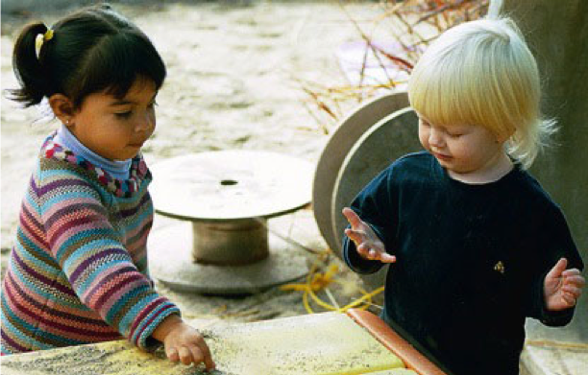
After Concerns are Shared
Assure the family that you are there to support the child and incorporate new ideas
Tell them you have information about services
within your program
local early intervention services
special education services
other potential resources
Notes:
Often, a family’s biggest fear is that the caregiver will reject their child if the child needs extra help. If caregivers let the family know that they are interested in getting resources or information to support their child’s success in their environment, the family is less hesitant to seek outside help.
Some caregivers may in fact want to remove a child from their setting. This discussion should not occur the first time that the caregiver shares concerns with the family. As the presenter, you may need to emphasize the partnership between the caregiver and the family. There may be help available for the child that would also help the caregiver continue to provide appropriate service. Additionally, the Americans with Disabilities Act* prevents exclusion or expulsion of a child based on disability, so this may also be an issue to consider.
It is important for the caregiver to be prepared with information and resources for possible next steps. They should be able to answer the family’s questions and, if work with an outside agency is suggested, clarify what the referral will accomplish. The caregiver can explain that a referral will provide an assessment, suggestions for supporting the child, and possible eligibility for services. The caregiver must remember not to guarantee eligibility. At this point in the process, everyone is just gathering information.
*More information on the Americans with Disabilities Act is available at the Map to Inclusive Child Care website: www.cainclusivechildcare.org/camap/legal.htm

Slide 14
The Family’s Response
Wait patiently as the family members think about and process the information you have shared
Let the family members take the lead in determining the next steps
The family may be interested in referrals and welcome your support or
The family may be upset and/or not ready to access resources at this time
It is important to be ready for any reaction and response from the family member
Notes:
In either situation, it is important for the caregiver to support the family’s decision in making a referral to the appropriate service provider or in waiting until the family is ready to act on the information that has been shared. Some tips for accepting and supporting either response are provided in the When Concerns Arise article and in the next few slides.

Slide 15
Supporting Families Who Want to Access Resources
Refer to early intervention program, local school district, or primary health care provider (pediatrician, family doctor, etc.)
Before the meeting with the family, know which agency is most appropriate and have phone numbers or contact information available in writing
Tell the family that, with their permission, you can provide information directly to the agency
Notes:
Contacting resource agencies ahead of time to gather information can be helpful. This allows the caregiver to explain to the family member what they can expect after the referral and what the possible outcomes from the referral might be.
Before discussing the particular child with the agency, the caregiver must have the parents’ permission. It is best to have written consent from the family before talking to the agency about the child. Some agencies prefer that the referral come directly from the family member. Other agencies are open to referrals from caregivers directly.

Slide 16
Supporting Families Not Ready To Access Resources
Everyone moves at a different pace and accepts information differently
Processing and integrating information will take families varying amounts of time
Unless behavior or other issues (e.g., medical urgency) prevent you from caring for child without assistance, allow family to proceed on their own timeline
Notes:
Sometimes the family may take in all of the information but not be ready to take action. The family’s emotional response will affect what they hear and understand. They also may have different expectations for their child due to their culture or family values.
The reality that their child may be different from other children is very hard for some families to hear.
Caregivers must be prepared to support the parent or family member in understanding what has been shared, repeating the information whenever necessary. Let them know that the resources are there whenever they want them. Some families may want to take time to do their own observations and consider what has been shared. In these cases, the caregiver may want to schedule another conference a few days or weeks later to share the resource information.
If the caregiver believes that not seeking help is an issue of neglect, then they do have an obligation to make that clear to the family and to make an appropriate referral to child protective services to address the area of neglect. Parent permission is not needed for a referral to child protective services.

Slide 17
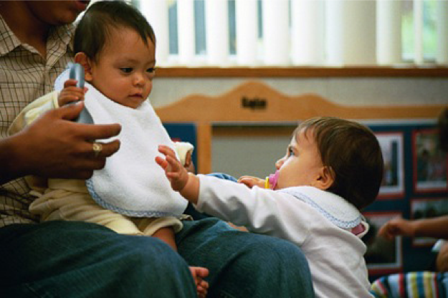
When the Family Does Not Agree With Your Concern or is Upset
The initial answer to your question of how the family sees their child’s development will provide a clue for how they may react (slide 11)
Your observations may surprise or upset a family
Use active listening skills
Support parents’ feelings
Suggest the family discuss this observation or information with other family members or another professional such as their doctor
Notes:
When infants and toddlers are distressed, caregivers have been taught to accept the feelings and empathize with the child. Parents can benefit from this same approach. It is important that the caregiver accepts the negative or upset feelings and empathizes with the parent. Understanding that anger and blame are common responses for people receiving bad news or in pain may help the caregiver to accept the feelings without taking them personally. The caregiver should resist the urge to be defensive and argue.
It is best if the caregiver can remain supportive and be clear that referral to an outside agency or assessment is a positive thing that can provide more information and resources to the family and the caregiver.
Both the family and the caregiver have the best interests of the child at heart. They just may have different perspectives on how to achieve that goal.
It may be helpful for the caregiver to realize that she has had time to think about the child’s developmental or behavioral differences, and therefore, is ready to pursue additional help. The family members may want the same opportunity for time to think, watch their child, and get additional information on their own.

Slide 18
After the Conference
Whatever the family decides, maintain ongoing communication with them
If the child is assessed by a health care provider, early intervention, or special education team, ask for them to share suggestions and recommendations
If the child is not eligible or does not receive services from an outside agency, the suggestions will still be useful to you
If the child does receive outside services, your communication will have set the stage for partnership and collaboration with family as well as the specialists to meet the needs of the child in your setting.
Notes:
This may be a good time to set up a regular method of communication between the caregiver and the family. They may want to use notes, phone calls, or even schedule regular meetings during the process of evaluation.
If a child is assessed and found not eligible, the family may think that there are no longer any concerns. It is often the case that the child has mild delays, but not significant enough delays to qualify for the specialized services. If the caregiver is able to receive a copy of the assessment, the information can be useful in terms of suggestions for the child and an understanding of how the child’s development is seen. Sometimes the caregiver can ask the assessment team or family member what to do if the child’s skills continue to be a concern.
When a child is found eligible and receives services, the active participation of the caregiver in the initial discussions with the family can help set up better collaboration among the agencies, family, and caregiver.

Slide 19

Get Support for Yourself
Sharing concerns with a family member requires planning, careful thought, and openness to the parents’ responses
This is one of the most demanding tasks for a caregiver
Be sure to reach out to colleagues and supervisors for support always maintaining confidentiality
Remember that your sensitive communication with the family can support the child to be all that they can be!
Notes:
Close the presentation by encouraging the caregivers to get support for this very demanding and emotional task. They can role play how they might share concerns, talk with the director of their program, check out their approach with a colleague, or celebrate a well-run conference.
Remind the participants that when getting support for themselves, they must respect the confidentiality of the family and child. If, in getting support, they are sharing information about the situation with someone outside of their program, they should change the names and any identifiable information to protect the privacy of the child and family.
The next slides have some general resources. It is recommended that you, as a presenter, gather some concrete referral names, numbers, or websites in your local area. End the presentation by reminding the participants that their caring for the child and sensitivity to the family will be the best thing for the child and family in the long run.

Slide 20
Resources for Families
Health and medical service systems
Start with the child’s primary health care provider
The California Childcare Health Program is a good resource for health information at https://cchp.ucsf.edu/
Local special education or early intervention services
The Family Resource Centers funded by California Early Start can be a starting point for early intervention or special education in the community at http://www.frcnca.org/
The local school district should be able to identify resources for referrals at https://www.cde.ca.gov/ds/si/ds/pubschls.asp
Child Care
Find the local Resource & Referral Agency at https://rrnetwork.org/
Notes:
In many cases, it is appropriate to have the family talk about their concerns with their primary health care provider (generally a pediatrician, nurse practitioner, or physician’s assistant). Some health care providers specialize in working with children with special needs while others have limited knowledge. Parents must be proactive in making sure that their medical provider is a good match in serving the child’s needs.
The referral to early intervention or special education should be made at the same time as a referral to the health care provider since the referral processes take time.
The website reference on the slide is for the Family Resource Center Network website. The website provides links to local Early Start Family Resource Centers that can identify the appropriate service provider for the family and suggest other resources that may be helpful. They are a wonderful resource for family members and caregivers.
For children over age three, the local school district may be the best place to start. Some school districts work through a central agency for referrals of children under age 6, and the local school district will have that information.
Remember, referrals are best made directly by the family. If a caregiver makes a referral, the family must have provided clear, written permission and the process is not likely to start until the family is contacted.

Slide 21
For More Information
Websites
California MAP to Inclusion & Belonging: https://cainclusion.org/camap/
California Preschool Instructional Networks (CPIN): https://cpin.us/
Program for Infant Toddler Care Partners for Quality (PITC PQ) Regional Support Network https://www.pitc.org/pub/pitc_docs/pqintro.html
California School-Age Consortium (CALSAC) https://www.calsac.org/
Notes:
These websites have additional resources which may be helpful to presenters as well as participants.
The California Map to Inclusive Child Care website has additional training PowerPointsTM, as well as information on inclusion of children with disabilities or other special needs, links to helpful websites, and county inclusive practice efforts.
CDE-CDD funds training through three regional networks (links provided)
CPIN – the California Preschool Instructional Network for preschool issues and information
PITC PQ RSN – the Program for Infant/Toddler Care Partners for Quality Regional Support Network) for infant/toddler issues and information
CALSAC – the California School-Age Consortium for school-age issues and information

